Slide 1
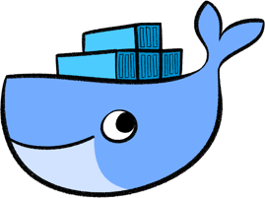
DOCKER
What is it? How can we use it?
Notes:
SI Play’s “LATO” font used throughout (Plain, Bold, Light). Be sure to download fonts on your own machine and presentation machine. If emailing a presentation, save as PDF and send.

Slide 2
AGENDA
Microservices
What is docker?
Benefits for developers
Benefits for IT
Demo
Conclusion

Slide 3
MICROSERVICES
High decoupling
Technology stack
Decentralized
Stateless
Notes:
Before start talking of docker, first we need to set the bases and understands why is it better to start thinking our applications as microservices, this term is not something new at all. This are a couple of properties that we can take when we think of a microservice:
Decoupling, it is important to have well defined functions, that have a very specific use.
Technology stack, lets take the advantage of writing each function with the best tool to do it
Highly decentralized, lets let the whole environment move whenever have enough space, without caring where is each microservice.
Microservices are designed to be stateless, since each one of them can be created at any time in any place and has to be ready to work.

Slide 4
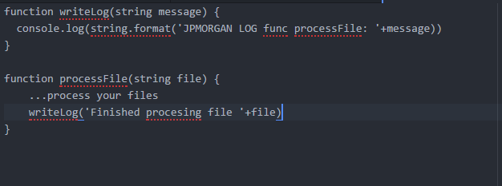
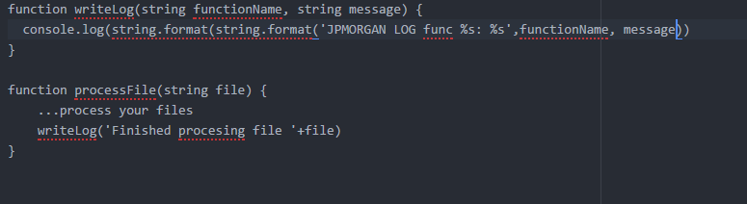
MICROSERVICES - DECOUPLING
Notes:
When we were first learning about programing one of the first terms one will see is decoupling. Basically a good practice in programing will be having a high decoupling, this means, write our code in a way that each module/function/class does not depends too much of each other. This sounds confusing at the beginning so lets take a look:
In the following examples we can identify the differences when we make a program which is highly coupled with another one which is decoupled. The first case is the coupled one, you can see that the function writeLog is coupled to processFile function since you wouldn’t be able to use the writeLog from another function rather than processFile. Instead the second case allow us to reuse writeLog function for another cases.
Writing program decoupled allow us to split our application into tiny parts that can be reused from different parts of the program, moreover, building our app like this, allow us to implement different strategies of availability. Lets suppose that writing the log is a heavy task that usually uses a lot of memory but it is not often used, while the processFile is not that heavy and also it is called 100x times compared with writeLog. If we couldn’t decouple them, we must ensure we have enough resources to allocate to run every instance of your application, while if we split them into two services, we can scale processFile easier since needs less resources.
Another important aspect is the impact on replacement, decoupled fuinctions are very easy to replace and rollback since the coupling is not high, moreover will discover that microservice orchestration allow us to do A-B testing, green-blue deployments and easy rollbacks.

Slide 5
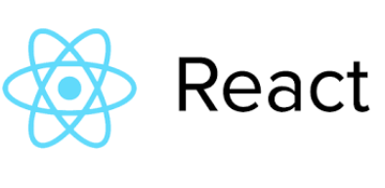
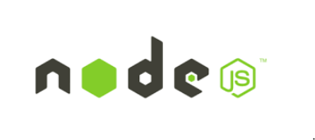

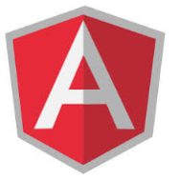

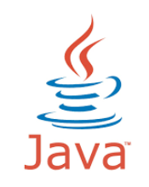



MICROSERVICES – TECH STACK
USE WHATEVER DOES BEST YOUR JOB!
Notes:
Having your application split into multiple of small services allows you to choose the best tool for the job. So let’s start thinking that maybe a good frontend would be a made in ReactJS, while a backoffice portal would be made in Symphony….our backend api will be made in Nodejs while our transactionManager will be made on Java or .NET.
We can enhance our applications by using what is most needed in each case, the following are a few examples on different criterias:
Has to be reliable
Has to be fast
Hast to be easy to develop front end

Slide 6
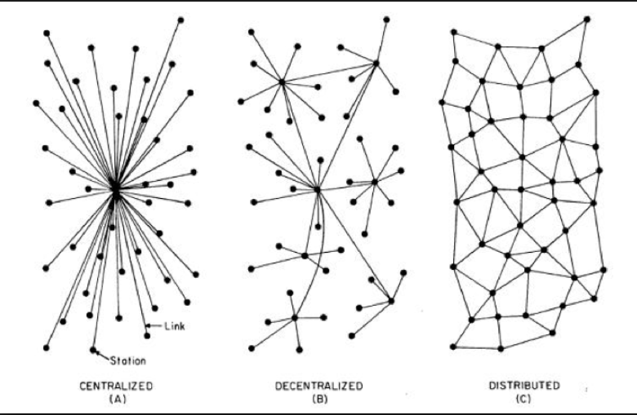
MICROSERVICES - DECENTRALIZED
Notes:
Traditional programing approaches think that one application must have one database where all the information that has to be persisted, should be inside of that database. When we start thinking on microservices we often makes ourselves the same question we did about decoupling and tech stack, so when we split up our application into smaller apps, should we split up the information as well? Well the first approach to think is, why not? Life are full of examples that makes us think it’s a good idea, a couple of examples could include: customers information from transaction, credit card information from transaction information, etc.
The same idea of why not using what’s the best tool for the job came up again with this, why don’t we use document databases to store searches and types of assets on our application and use classic relational databases to securely store transactions, orders and stock? Why don’t we store information that is going to be used very often in a memory database such as redis or memcache?
So this is the first concept of decentralized, each function takes care of its own, we could also talk about distributed, which is also a case of microservices, how are going to use the nearest or available instance of the layer X? well I’ll postpone this later in this course.
So, what’s the difference between decentralized and distributed?
Distributed means computation is spread across multiple nodes instead of just one. Decentralized means no node is instructing any other node as to what to do. A lot of Stacks such as Google have adopted a distributed architecture internally to speed up computing and data latency. This means that a system can be both centralized and distributed.
Can a system be both distributed and decentralized?
Yes, it can. Bitcoin is distributed because its timestamped public ledger, the blockchain, resides on multiple computers. It’s also decentralized because if one node fails, the network is still able to operate. That means that any app that uses a blockchain alongside other peer-to-peer tools can be distributed and decentralized.

Slide 7
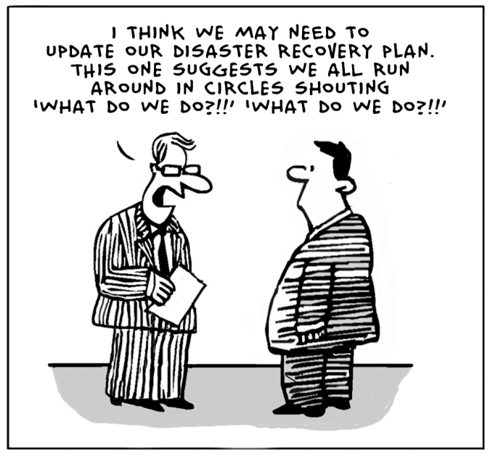
MICROSERVICES - STATELESS
Notes:
So one of the most important aspects of microservices is the fact that it does not hold any session. We will go deep in further slides, but it is important to hold the importance of designing services that are stateless, of course this is not a requisite, but it makes the life easier, whenever we can, let clients hold the state and let the backend live, die and be replaced without making the end user suffer because of that.

Slide 8
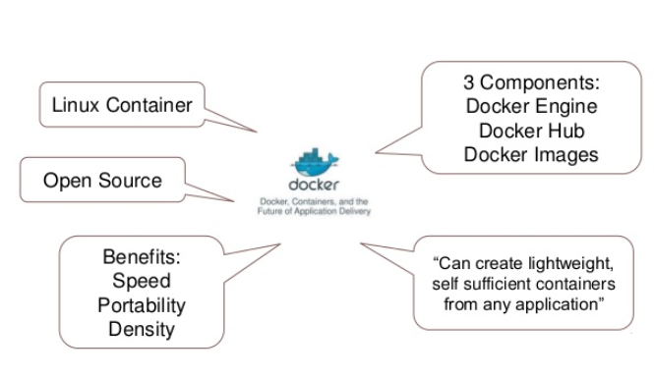
WHAT IS IT? DOCKER
Notes:
So docker is one technology to build our microservices. It is not only about linux, but most important are on linux. It uses some linux capabilities to create containers. So linux allow a process to be run in its own control group isolatedly allowing him to have their own namespaces (mnt, net, usr,etc). This pretty basic definition let us think, the first important thing docker brings: velocity, compared with virtualization, it is less expensive to spawn a process rather than creating a new virtual server. Also, it allow us to implement any linux implementation for your container, so you can choose from your preferred distribution.
Definitions:
Docker engine: this is the local orchestrator, in any architechture you need this engine running on your phisical host. It will take care of manage your containers.
Registry: this is the source of your containers, each container will run an image of your code, this will be stored on the registry.
Hub: is the public registry of images.

Slide 9
WHAT IS IT? DOCKER - FEATURES
PORTABILITY
INMUTABILITY
SPEED OF BUILD
SPEED OF DEPLOY
INFRASTRUCTURE AGNOSTIC
Notes:
Features:
Portability: each image is selfcontained, it means it has all the necessary dependencies inside in order to have your application running.
Inmutability: once your image is build, you can’t change it, any change will endup on a new image.
Speed of build: docker uses a versioned stack of executions that builds the image, every time you change something, it will build from the changed version of the stack, improving the time to build images.
Speed of deploy, once the image of your application is locally stored on your server, spawning containres of your image will happen within seconds.
When talking aobut docker you don’t need to think again about your IT dependencies, since it is all included inside the container, your runtime version such as java, .net, php, etc. The same with the OS specific, will also be included withing the image.

Slide 10
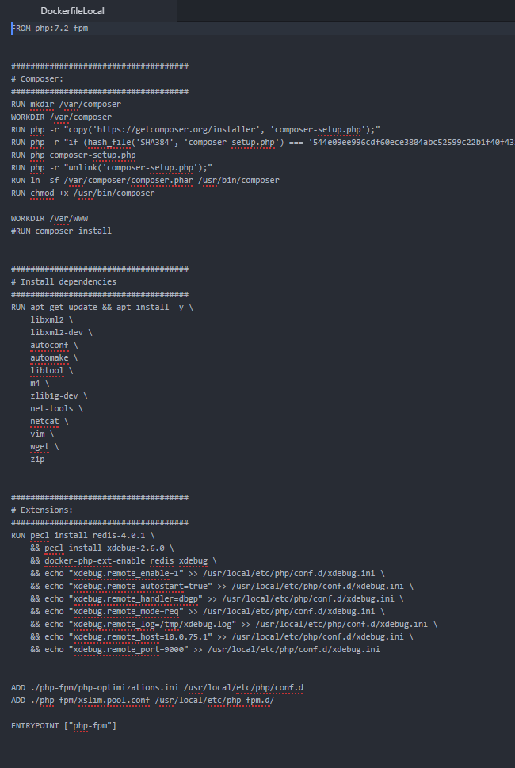
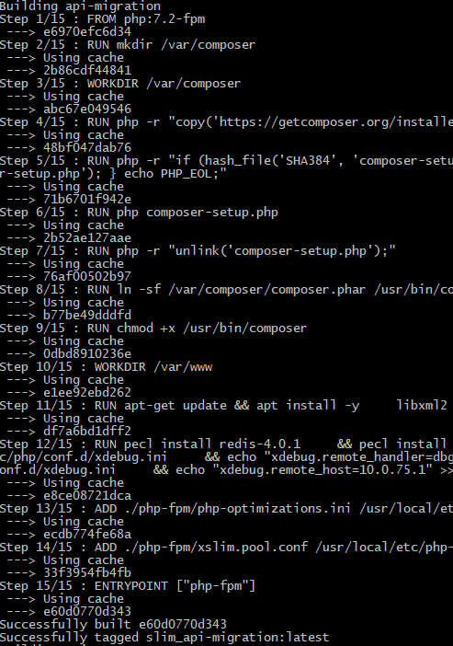
WHAT IS IT? DOCKER - DOCKERFILE
Notes:
Explain what is a dockerfile

Slide 11
WHAT IS IT? DOCKER – FOR DEVS
PORTABILITY
SPEED OF BUILD
INFRASTRUCTURE AGNOSTIC
CHALLENGES
Notes:
Portability: you can easily share your environment setup along all the team. (no need to be an expert on any matter, anyone can use the environment without going too deep on what’s installed).
Speed of build: in the case of devs, the speed happens from the same moment you build your app, since it will work the same way locally than in the build server (moreover you could push your own image).
Infrastrucrure agnostic: no need to take care of dependencies such as redis, mysql, mq, you can now run almost everything from your local docker
When thinking on microservices we will face a new set of challenges we need to mitigate in order to get our app working and scaling properly.

Slide 12
WHAT IS IT? DOCKER – CHALLENGES
BALANCING
SERVICE DISCOVERY
CONFIGURATION MANAGEMENT
Notes:
So once you have your entire application split into smaller ones with the ability to be spawn across your entire datacenter, the first proble you will face is, how are you going to balance the load? The second and maybe more important aspect will also be, how are you going to instantly identify where are the instances of your service executing?
This questions have to be solved using a tool for service discovery (speak about consul and differences with K8s).
The final thought wich is important as well, is how are going to make configuration changes across thousands of instances of your running image? Again there are tools to spread configuration changes along all microservices.

Slide 13
WHAT IS IT? DOCKER – FOR IT
SPEED OF PROVISION
EMPOWER DEVELOPER TEAMS
BALANCING THE LOAD
Notes:
Creating new environments should be easy to do, even you can leverage your dev team to manage their own environments on demand, without wasting resources unnecessarily.
You don’t need to worry again on dev access, as an IT operator, you would let devs to get inside the container without worrying about the possible damage inside the container, since it is completely isolated and stateless, so you can easily replace any instance of your application and what a developer can do inside the container is very limited.
Since your application will be stateless you don’t have to worry about failing nodes, moving from one instance to another one, will end up in almost zero customer impact and you can complement this with any provisioning tooling existing in the market to replace the host.
Adding/Removing instances of your microservice within seconds, taking advantage of your whole infrastructure capacity, being also able to scale parts of your application isolatedly.

Slide 14
DEMO
Dockerfile
Docker-compose
Scaling
Configuration Management

Slide 15
CONCLUSION
Docker as a tool for developing microservices is a great opportunity for developers as for IT people who needs to start thinking on organizations that moves faster. It provides a common language for devs and IT people.

Slide 16
Questions?
<EOF/>

